Slide 1
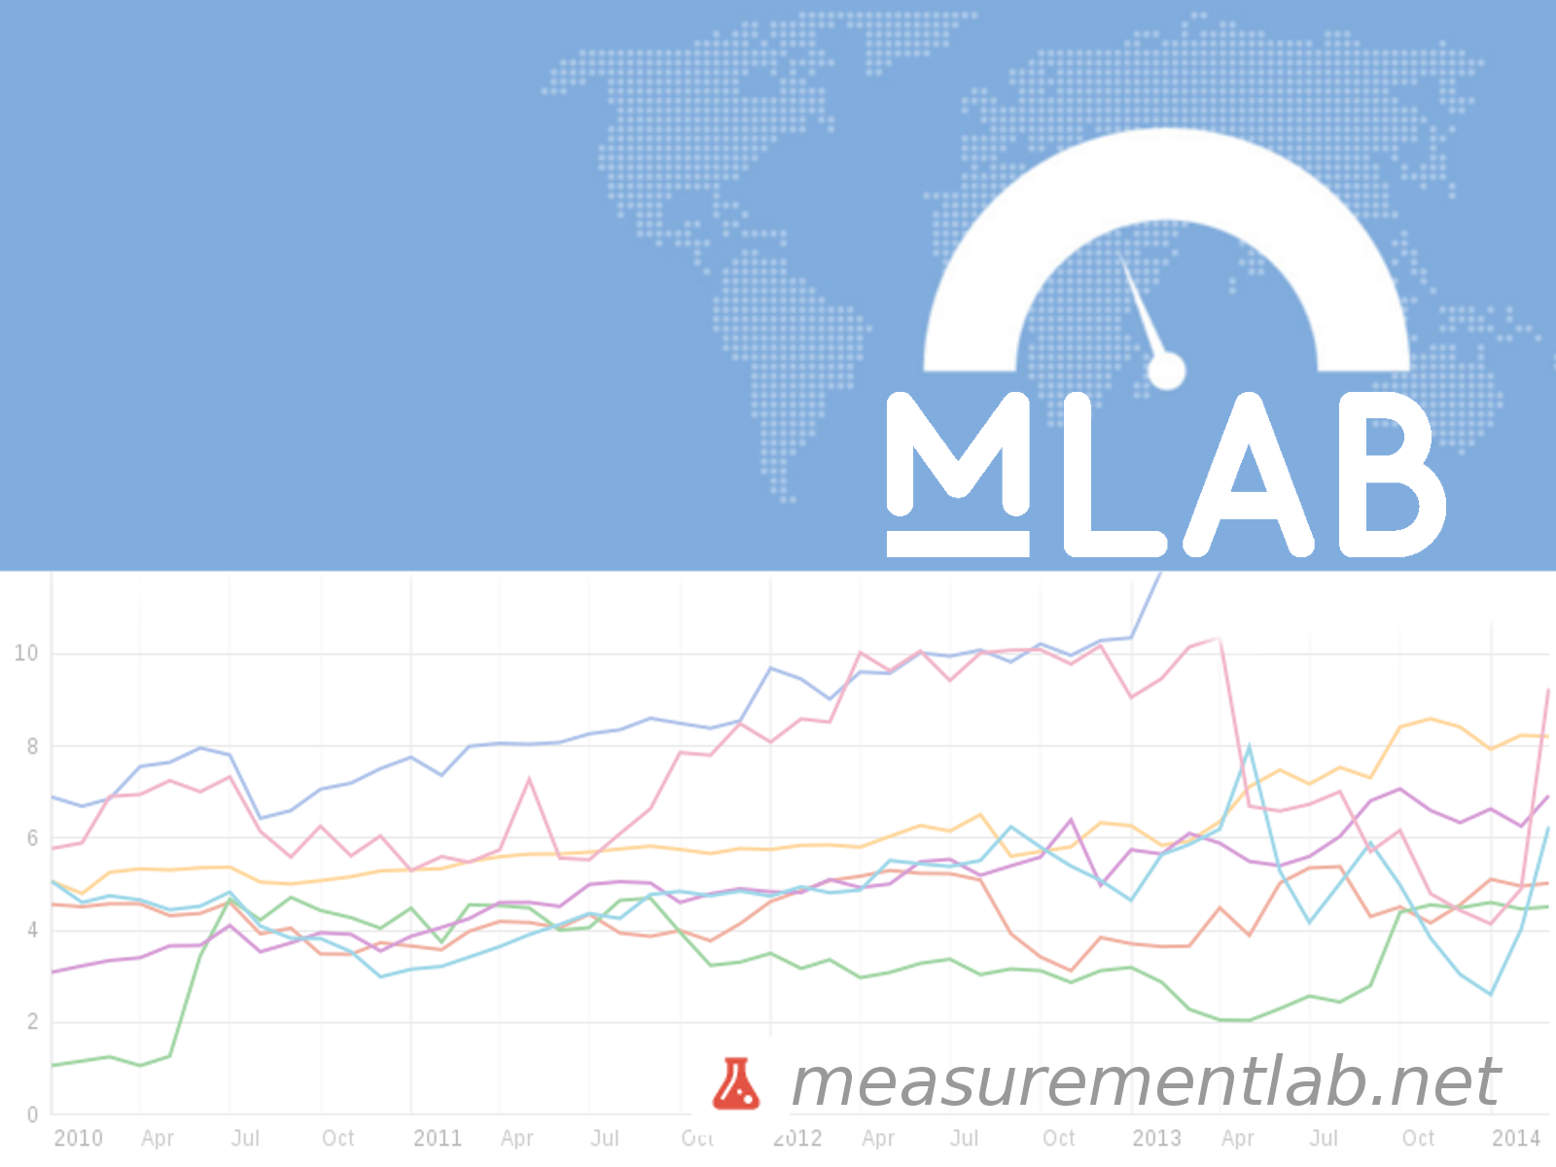
Alan Davidson
V.P. Technology Policy and Strategy, New America Foundation
Director, Open Technology Institute

Slide 2






How can we understand our connections to the Internet?
Notes:
We want to especially note that this is about diagnosing more than just YOUR connection. It is about diagnosing the Internet.
Begin by asking a series of rhetorical questions:
- Why doesn’t the Internet just work? Who or what is responsible?
- How do we ferret out the root causes of less than perfect performance?
- How can we know if our connections are being monitored, re-routed or throttled.
That we couldn’t find easy answers to these questions is why we started M-Lab.
To answer them we needed independent, reliable data. And it didn’t exist.
Consumers and regulators had no independent data.

Slide 3
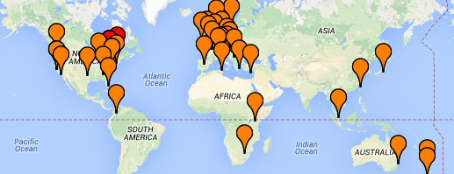
So, what is it?
Hundreds of servers running twelve network experiments
927 Terabytes of publicly accessible data
100% open source
Notes:
M-Lab is a crowdsourced, data collection platform, at the intersection of big data and citizen science.
The goal of M-Lab is to advance network research and empower the public with useful information about their broadband and mobile connections.
By enhancing Internet transparency, M-Lab helps sustain a healthy, innovative Internet.
M-Lab's data is public, academically rigorous and independent of industry and government interests. Because the services provided by the Internet are increasingly critical to everyone's day-to-day life, it is also critical to have a means of verifiable accountability for those services, systems, companies and regulatory bodies that currently have virtually no accountability to anyone.
Right now we can use M-Lab data to show proof of anti-competitive activity; to confirm whether we're getting the Internet speed we paid for;
and to look for evidence of governments and network owners slowing down the Internet, blocking content, or manipulating traffic in ways that aren't normal.
Ok. So, what is M-Lab again? :)
hundreds of servers on all inhabited continents
twelve network measurement experiments produced by independent academic and industry researchers
What are the latest stats?
338.28 million tests to date
250K test per day (check and update)
500GB of data per day
927 Terabytes of data (TB)

Slide 4

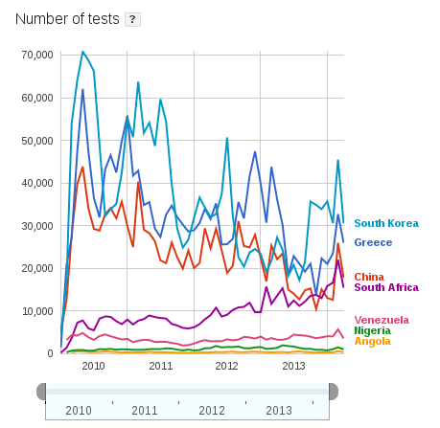


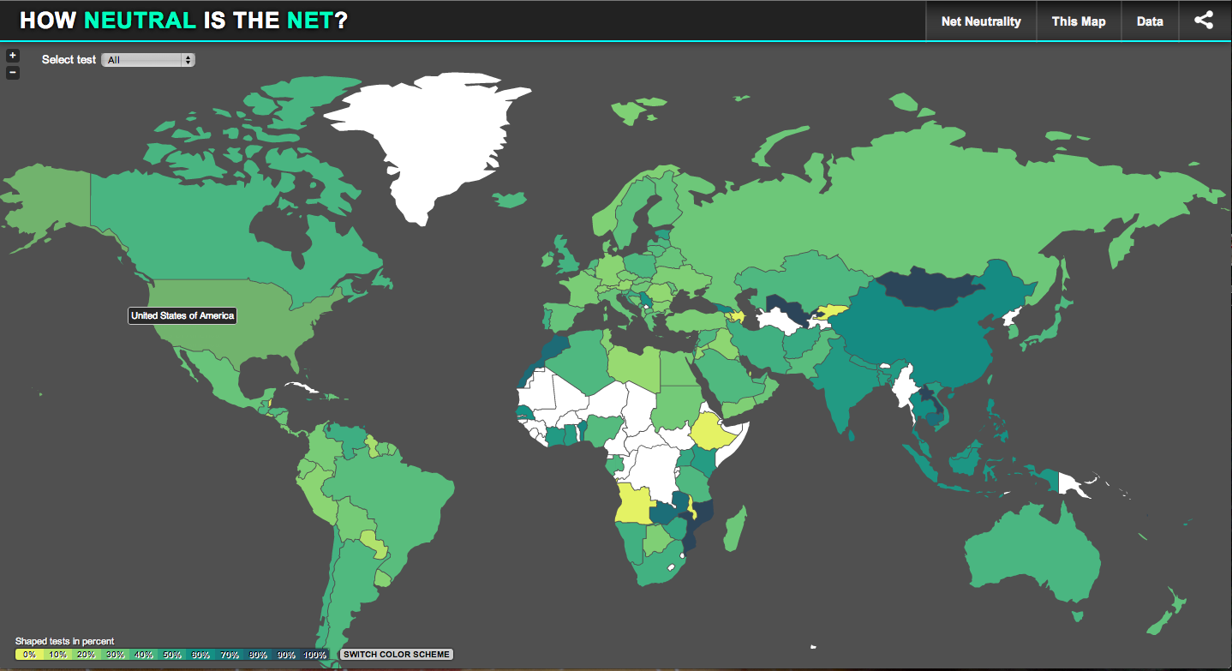

Current Examples of M-Lab’s Impact
Collin Anderson: Dimming the Internet ...
http://goo.gl/FCfjJI
Stacey Higginbotham - There’s something rotten in the state of online video streaming http://goo.gl/RFoiil
Google’s Public Data Explorerhttp://goo.gl/r6DdZy
Notes:
Publications using M-Lab’s data are listed on our Publications page: http://www.measurementlab.net/publications
Collin Anderson - Dimming the Internet: Detecting Throttling as a Mechanism of Censorship in Iran
Using M-Lab's NDT data to analyze Iranian Internet throttling and censorship.
Gigaohm story
http://gigaom.com/2014/02/06/theres-something-rotten-in-the-state-of-online-video-streaming-and-the-data-is-starting-to-emerge/
Visualizations
PDE

Slide 5
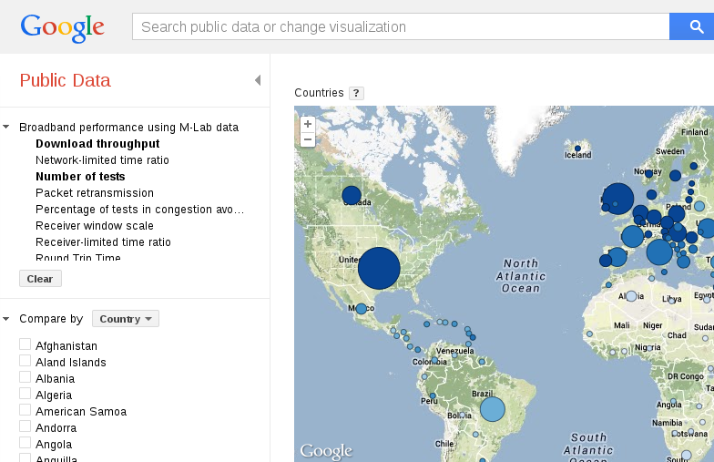
Notes:
Illustration of tools we have now… next slide, tools we want to be providing...

Slide 11
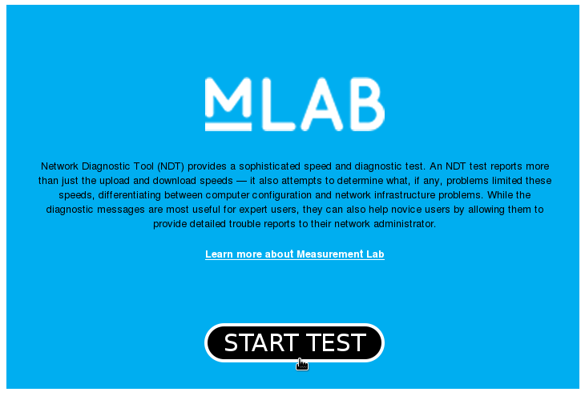
Notes:
CALL TO ACTION GRAPHIC
Need and Future - what is Knight funding?
Up until now, the platform has been operated for researchers, by researchers. As such, it has become a significant technical resource for the Internet measurement community -- but does not have the broad applicability and accessibility that it needs to support truly transformative analyses and reporting.
Knight’s support will enable M-Lab to support a broader set of users like journalists, consumers, citizens, activists, regulators, and advocates, who want to understand more about what’s happening on the Internet. We need to make our tools easier to use and more accessible.
We also plan to continue expanding in the area of measuring Internet Interference. (aka censorship) For example, it should be easy for a journalist to use M-Lab data to write a story on Internet censorship in Syria.
To do this, we are improving M-Lab’s platform infrastructure (more servers in more places with more diverse backhaul providers) and continually growing the size and depth of our datasets. And that’s where you come in.

Slide 12
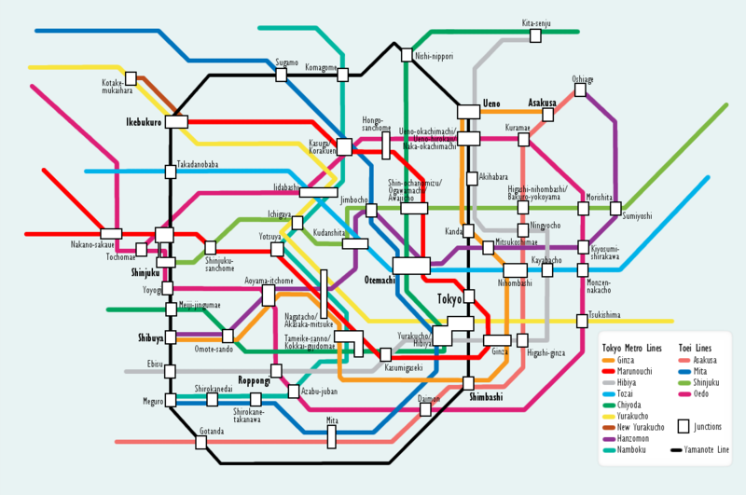
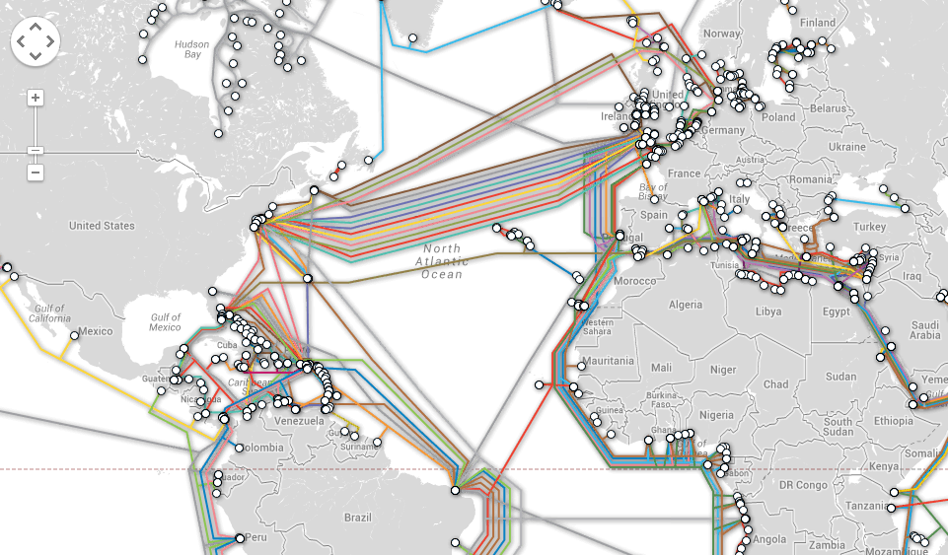
Notes:
We want to make M-Lab visualizations available and accessible in visual analogies that makes sense to non-experts. We imagine that our data travels through the Internet like we travel through the subway. Point A to point B, through various interchanges and transfers, sometimes with an occasional or not so occasional delay, but for the most part to from origin to destination.
What we know of course is that this isn't true. An email to your colleague down the hall will travel much more circuitously, and has the potential to be monitored, redirected, or completely stalled along the way.
LEFT: Map of the Tokyo subway system.
http://commons.wikimedia.org/wiki/File:Tokyo_subway_map.PNG
RIGHT: Telegeography Submarine Cable Map
http://www.submarinecablemap.com

